Slide 1

Viva Connections & SharePoint Framework Bi-weekly sync
aka.ms/m365pnp
Your host in this call: Patrick Rodgers
Call begins at 7:00 AM PT / 3:00 PM GMT
June 16, 2022
Microsoft 365 PnP Team

Slide 2
Viva Connections & SharePoint Framework Bi-weekly sync
aka.ms/m365pnp
Your host in this call: Patrick Rodgers
June 16, 2022
Microsoft 365 PnP Team

Slide 3
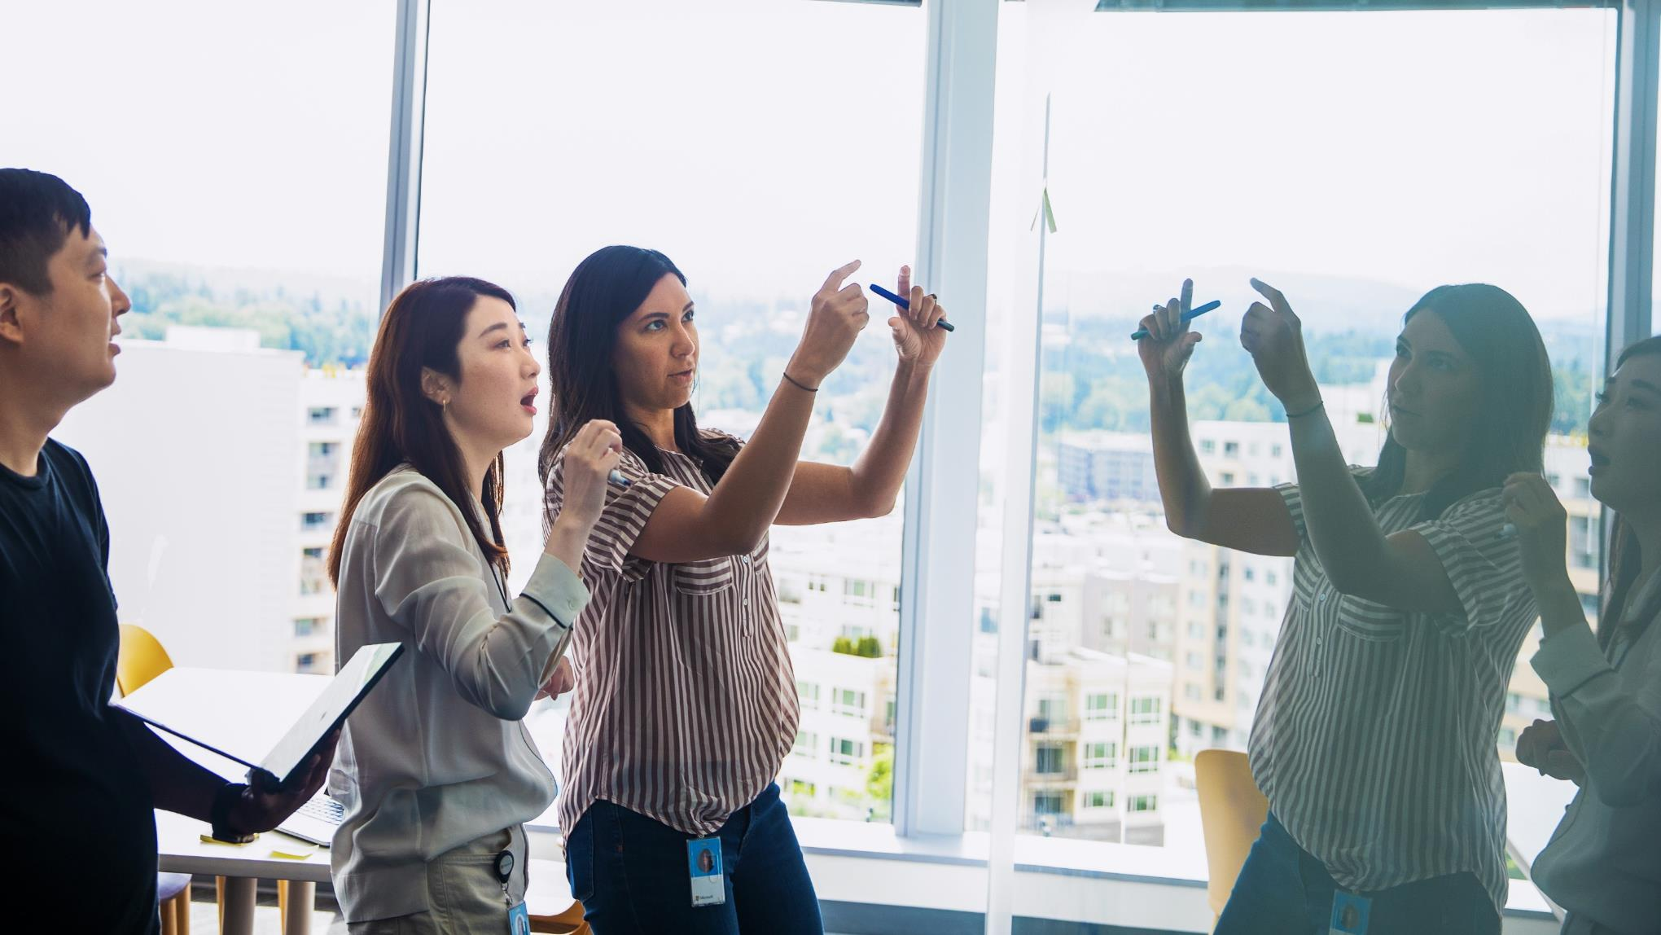




Agenda
Latest update on SharePoint Framework
Patterns and Practices Updates
PnPjs
CLI for Microsoft 365
Reusable PnP SPFx controls
New Community Samples
Picture time with Together Mode!
Demos
Christophe Humbert – Aiming for a safer Content Editor Web Part
Emanuele Bartolesi - Getting started on using GitHub Codespaces with your SharePoint Framework solutions
Siddharth Vaghasia – MyShifts - Adaptive Card Extension
Have a great day! 👍
You are awesome! 🧡
Thank you for being part of the community 👏

Slide 4
Opportunities to Participate in PnP SPFx / JS SIG
SPFx Demo
@pnp Demo
Contribute on GitHub
Provide Feedback
Web Part
Application Customizer
Provisioning
Anything you create!
PnPjs
CLI for Microsoft 365
SPFx Reusable Controls
SPFx Community Yeoman
Report Issues
Submit Pull Requests
Help with issues/questions
How are the calls?
Documentation needs?
Where can we help?
Positive is OK too!
Great opportunity to get visibility for you or your company. Demo sample or explain how you extend or customize SharePoint Online with live demo in your projects. Reach out to team for volunteering.
Request a demo spot on the call
https://aka.ms/m365pnp/request/demo

Slide 5
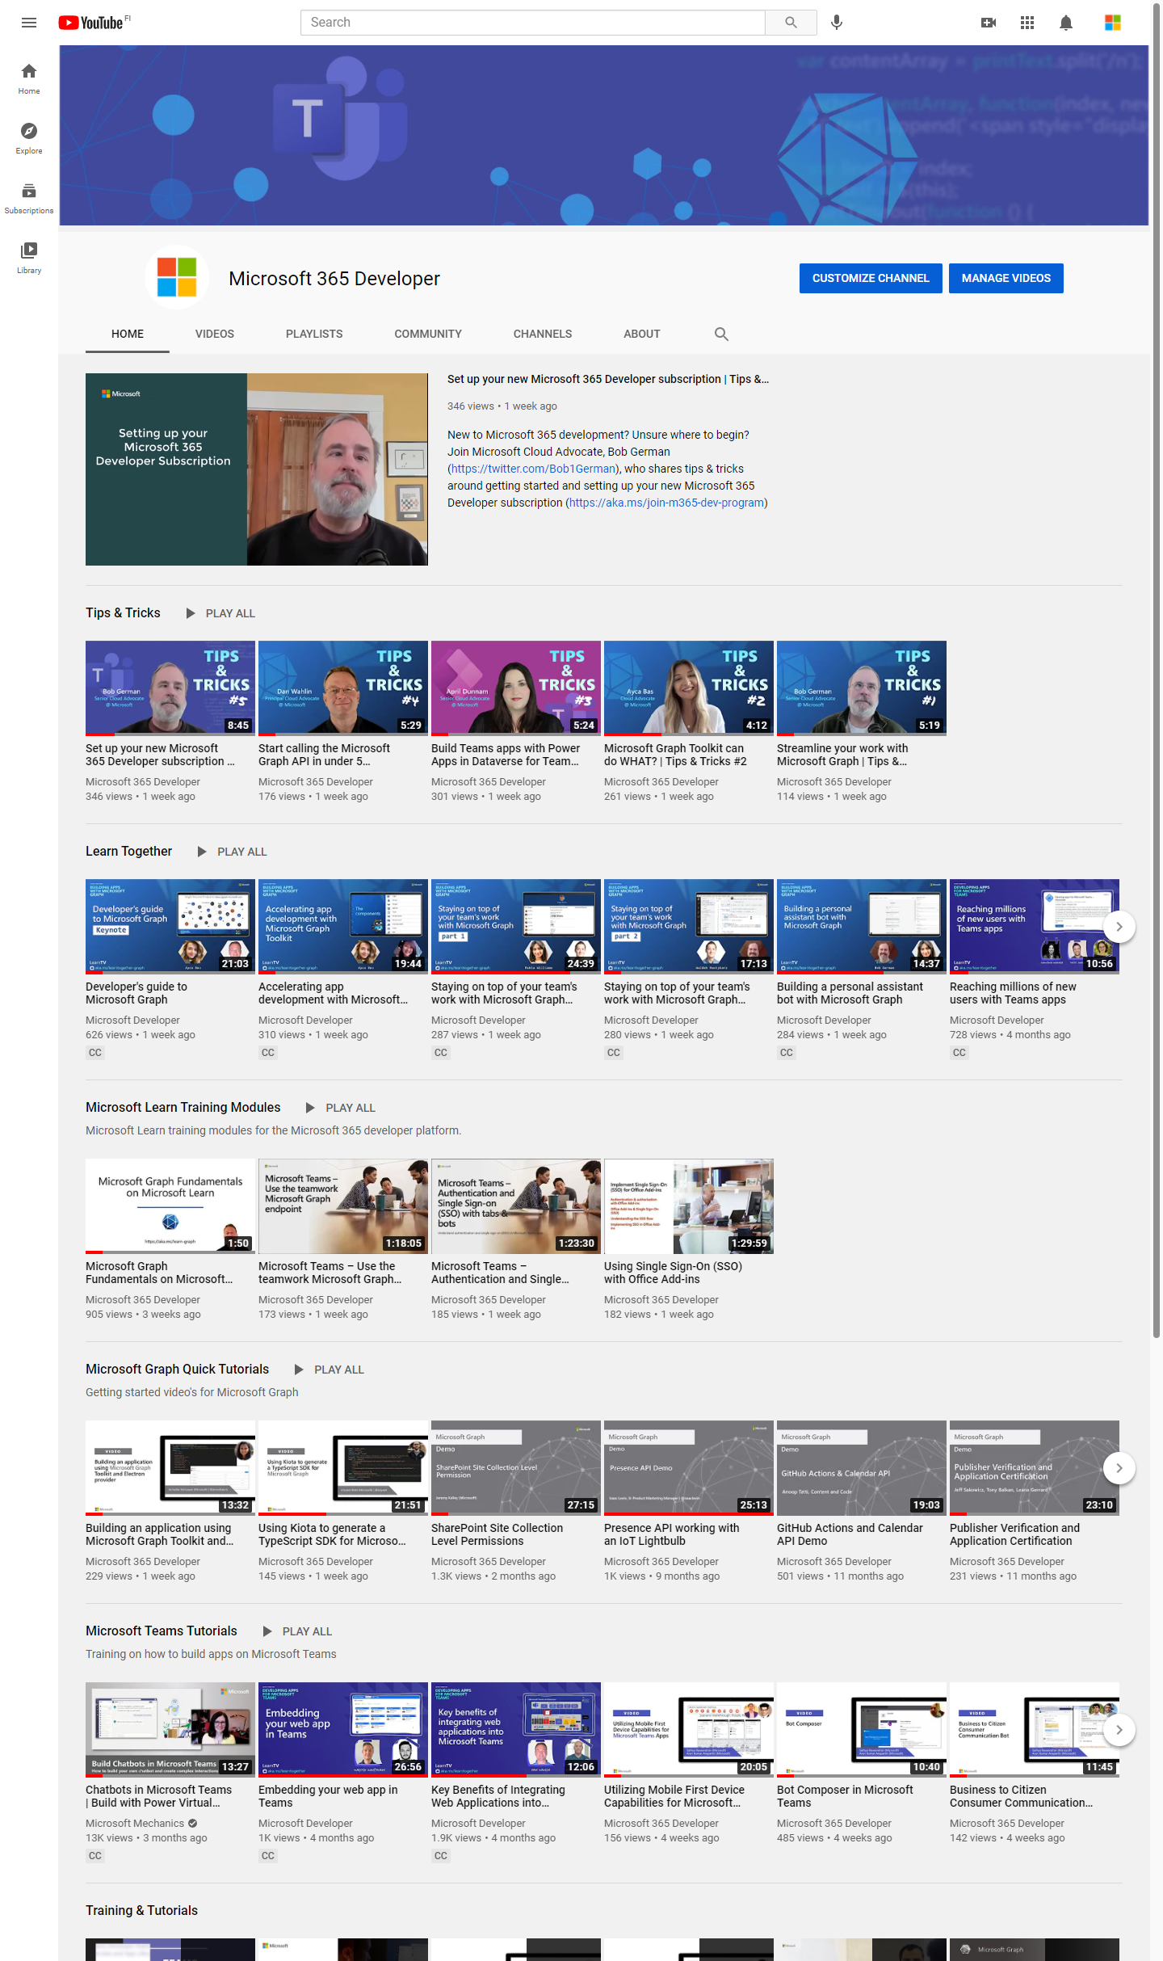
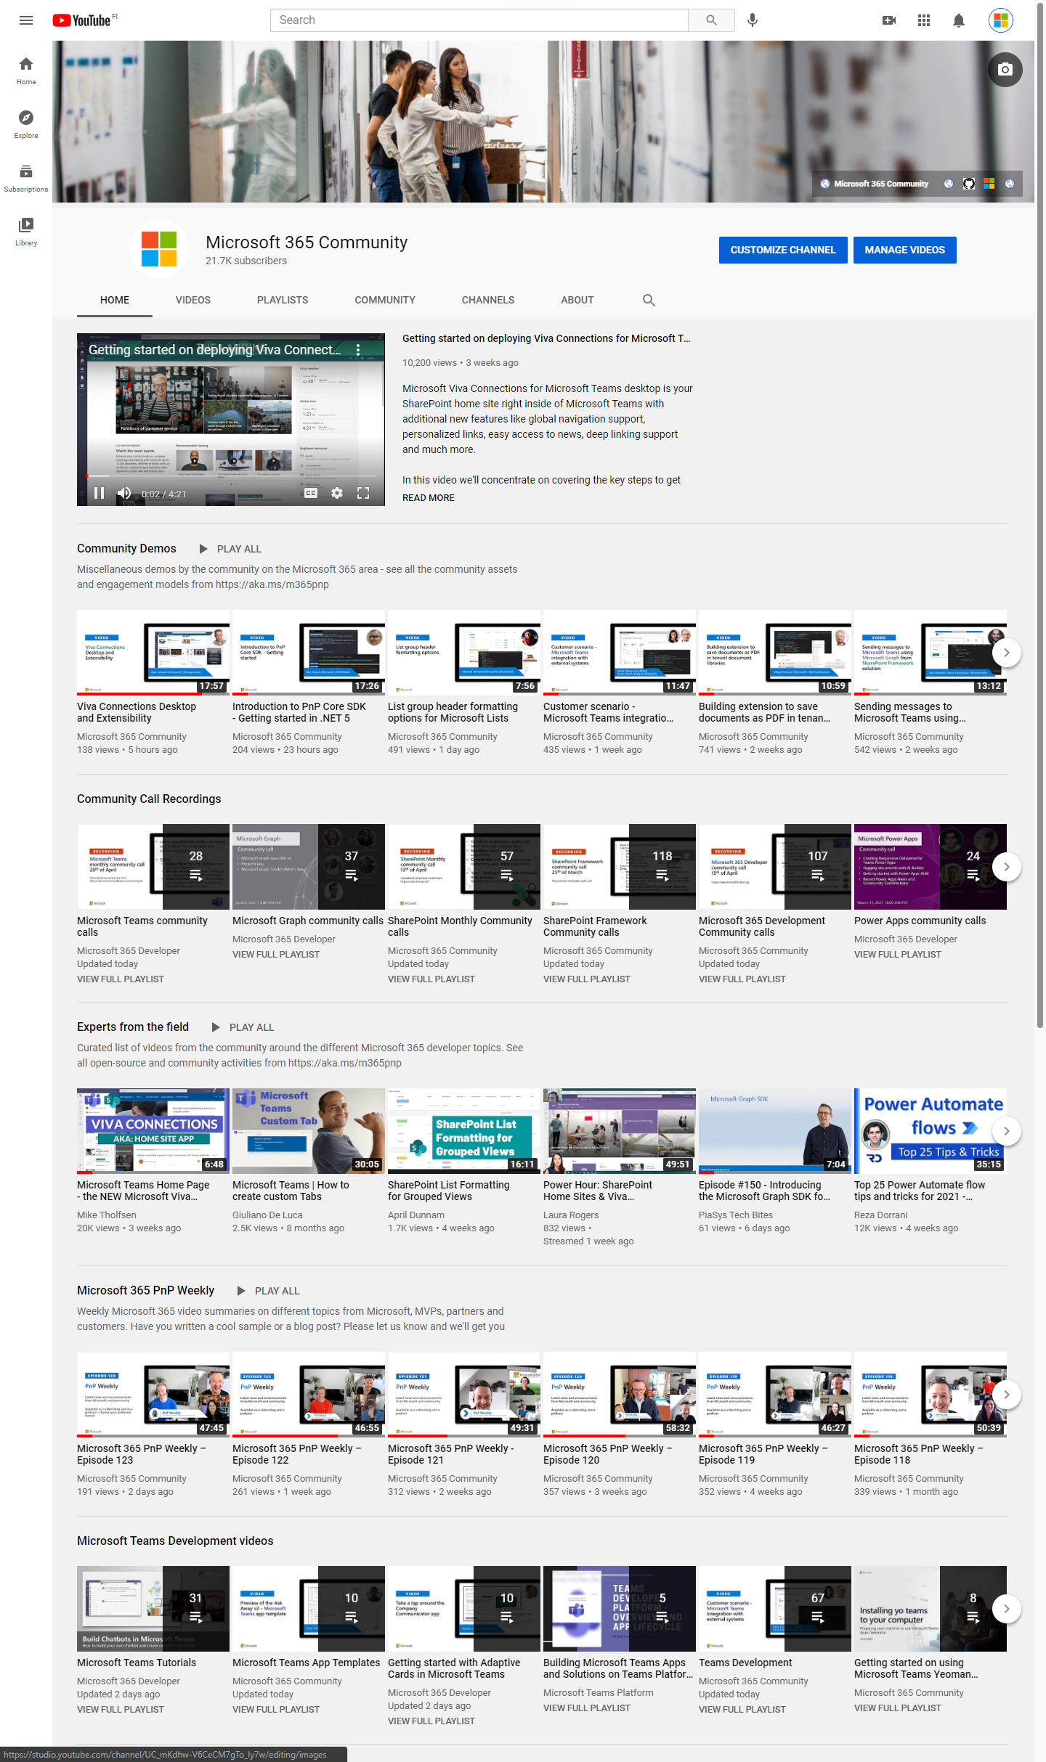
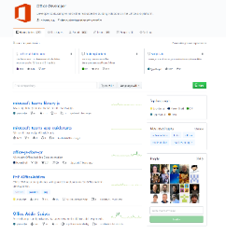
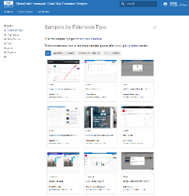
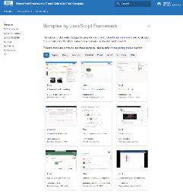
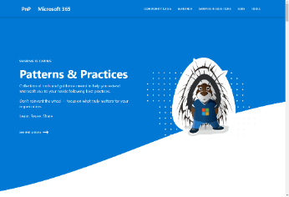
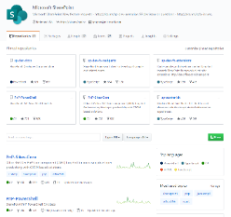
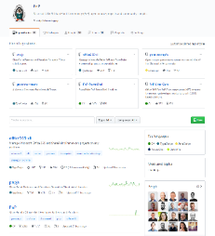
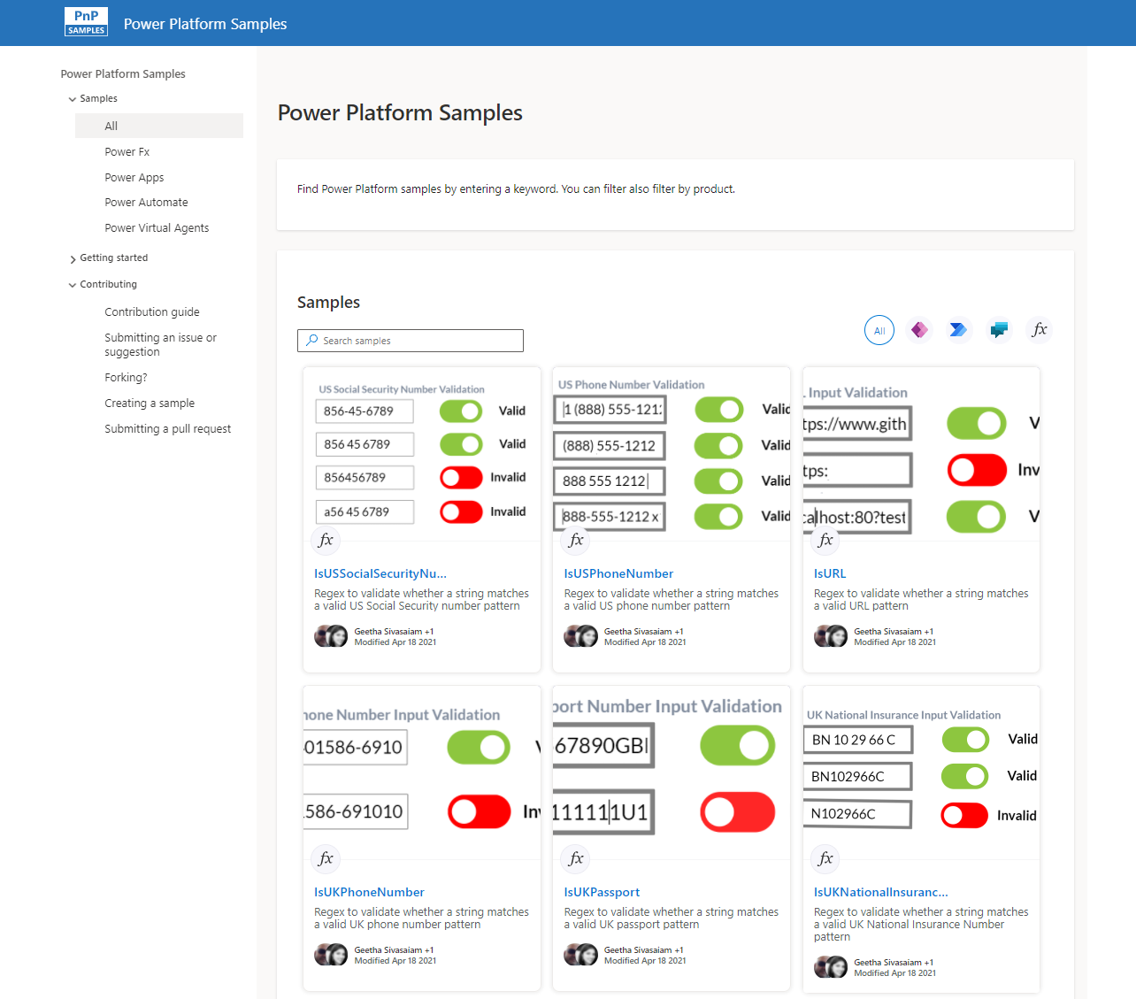
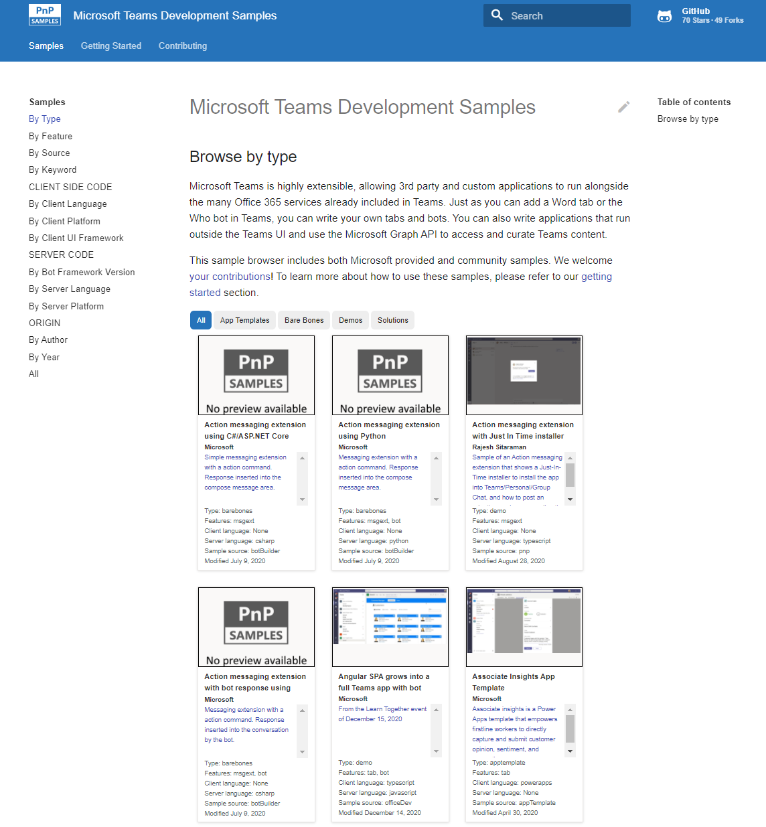
Microsoft 365 developer videos
Microsoft 365 community videos
Open-source
Sample galleries
Open-source initiatives and samples
aka.ms/m365devyoutube
aka.ms/m365/videos
github.com/pnp
github.com/officedev
github.com/microsoftgraph
github.com/sharepoint
aka.ms/m365/samples
aka.ms/teams-samples
aka.ms/spfx-webparts
aka.ms/spfx-aces
aka.ms/powerplatform-samples
aka.ms/spfx-extensions
aka.ms/list-formatting
aka.ms/m365/community
@Microsoft365Dev | @m365pnp
One URL to rule them all…

Slide 6
Microsoft 365 developer community calls
Microsoft 365 platform (weekly) https://aka.ms/m365-dev-call
(Notice. This call is on a summer break between July 1st and 31st of August 2022)
Adaptive Cards https://aka.ms/adaptivecardscommunitycall
Microsoft identity platform https://aka.ms/IDDevCommunityCalendar
Office Add-ins https://aka.ms/officeaddinscommunitycall
Power Platform https://aka.ms/PowerPlatformCommunityCall
Microsoft 365 and Power Platform community (bi-weekly) https://aka.ms/m365-dev-sig
Viva Connections & SharePoint Framework (bi-weekly) https://aka.ms/spfx-call
Download recurrent invites from
https://aka.ms/m365/calls
Notes:
m365-dev-sig

Slide 7
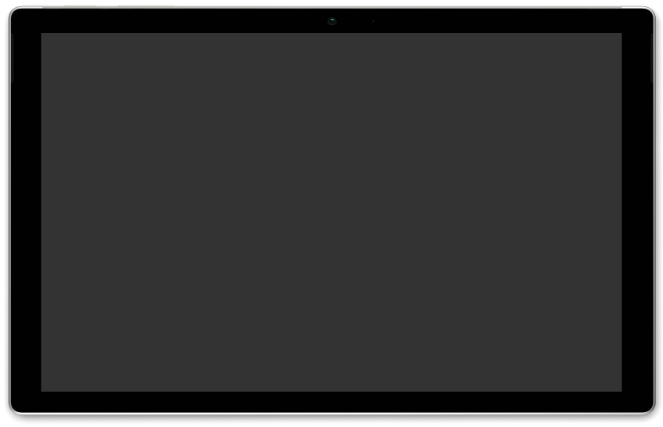






Latest news from Microsoft engineering on Microsoft 365 topics
Monthly community contributors
Community together mode group photo
Rabeb Othmani - Microsoft Graph Postman
Nik Charlebois - Using the Microsoft Graph PowerShell SDK for common operations
Alex Kwan - Get started with UI Library for Azure Communication Services
AGENDA
Microsoft 365 platform call 21st of June @ 8 AM PT
Weekly call with Microsoft presenters covering the latest Microsoft 365 platform updates
Download recurrent invite from https://aka.ms/m365-dev-call
Notes:
Dan’s slide

Slide 8
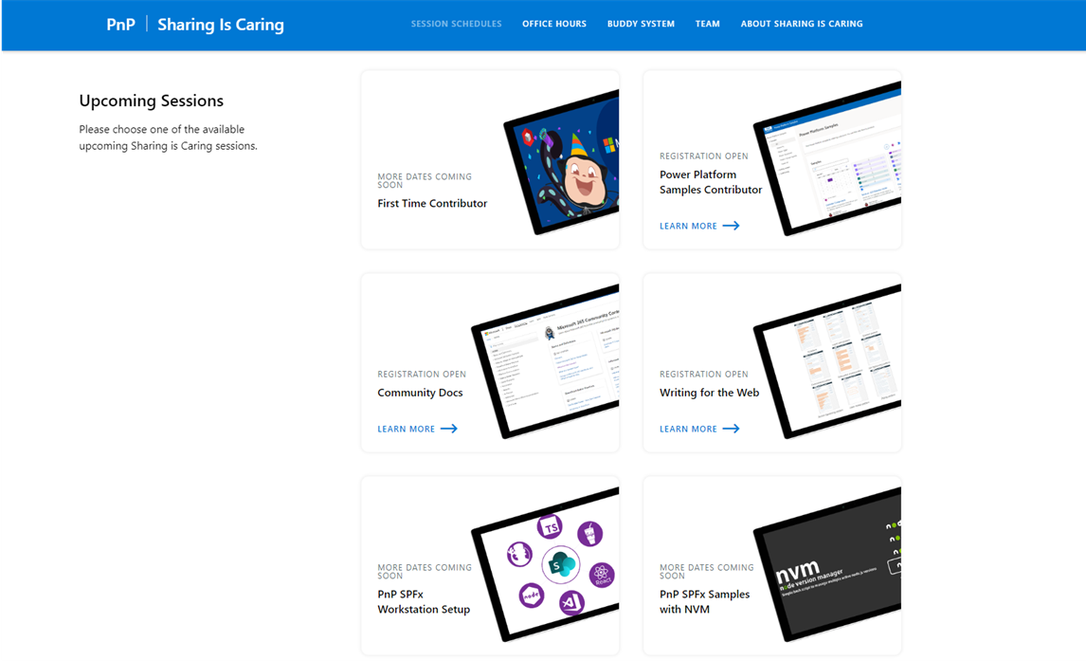
GUIDANCE
Learn how to get started in the open-source PnP community!
Upcoming Sessions:
First-time contributor
Power Platform Samples Contributor
Writing for the Web
Community docs
Using PnP SPFx samples w/ NVM
SPFx developer workstation setup
More than code with VS Code
First-time presenter
M365 Maturity Model Practitioners
Power Platform – Power Pages
COMING SOON!!!
https://aka.ms/sharing-is-caring
Notes:
25 Total attendees, 16 attendees who attended both First-Time Contributors and Community Docs sessions.

Slide 9





COMMUNITY
PnP Recognition Program
Showcase your contributions
Powered by Credly
More achievement levels coming soon
https://aka.ms/m365pnp-recognition
Notes:
25 Total attendees, 16 attendees who attended both First-Time Contributors and Community Docs sessions.

Slide 10
SharePoint Framework Latest from Microsoft engineering for Microsoft Viva, Microsoft Teams and SharePoint extensibility

Slide 11
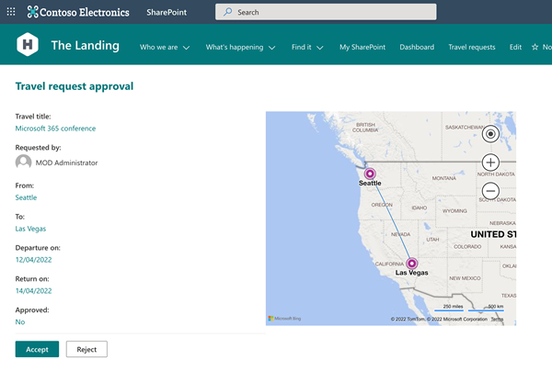
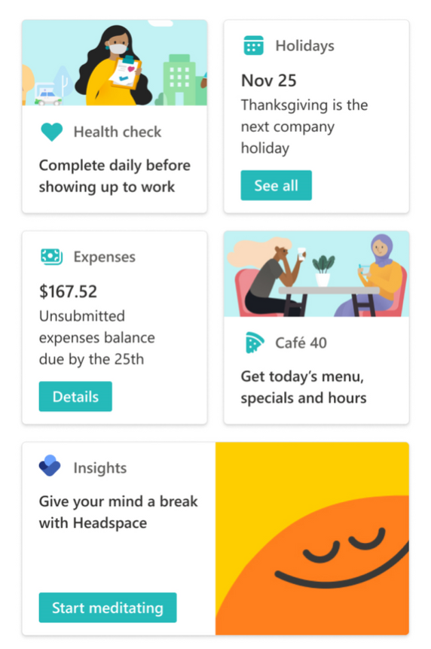
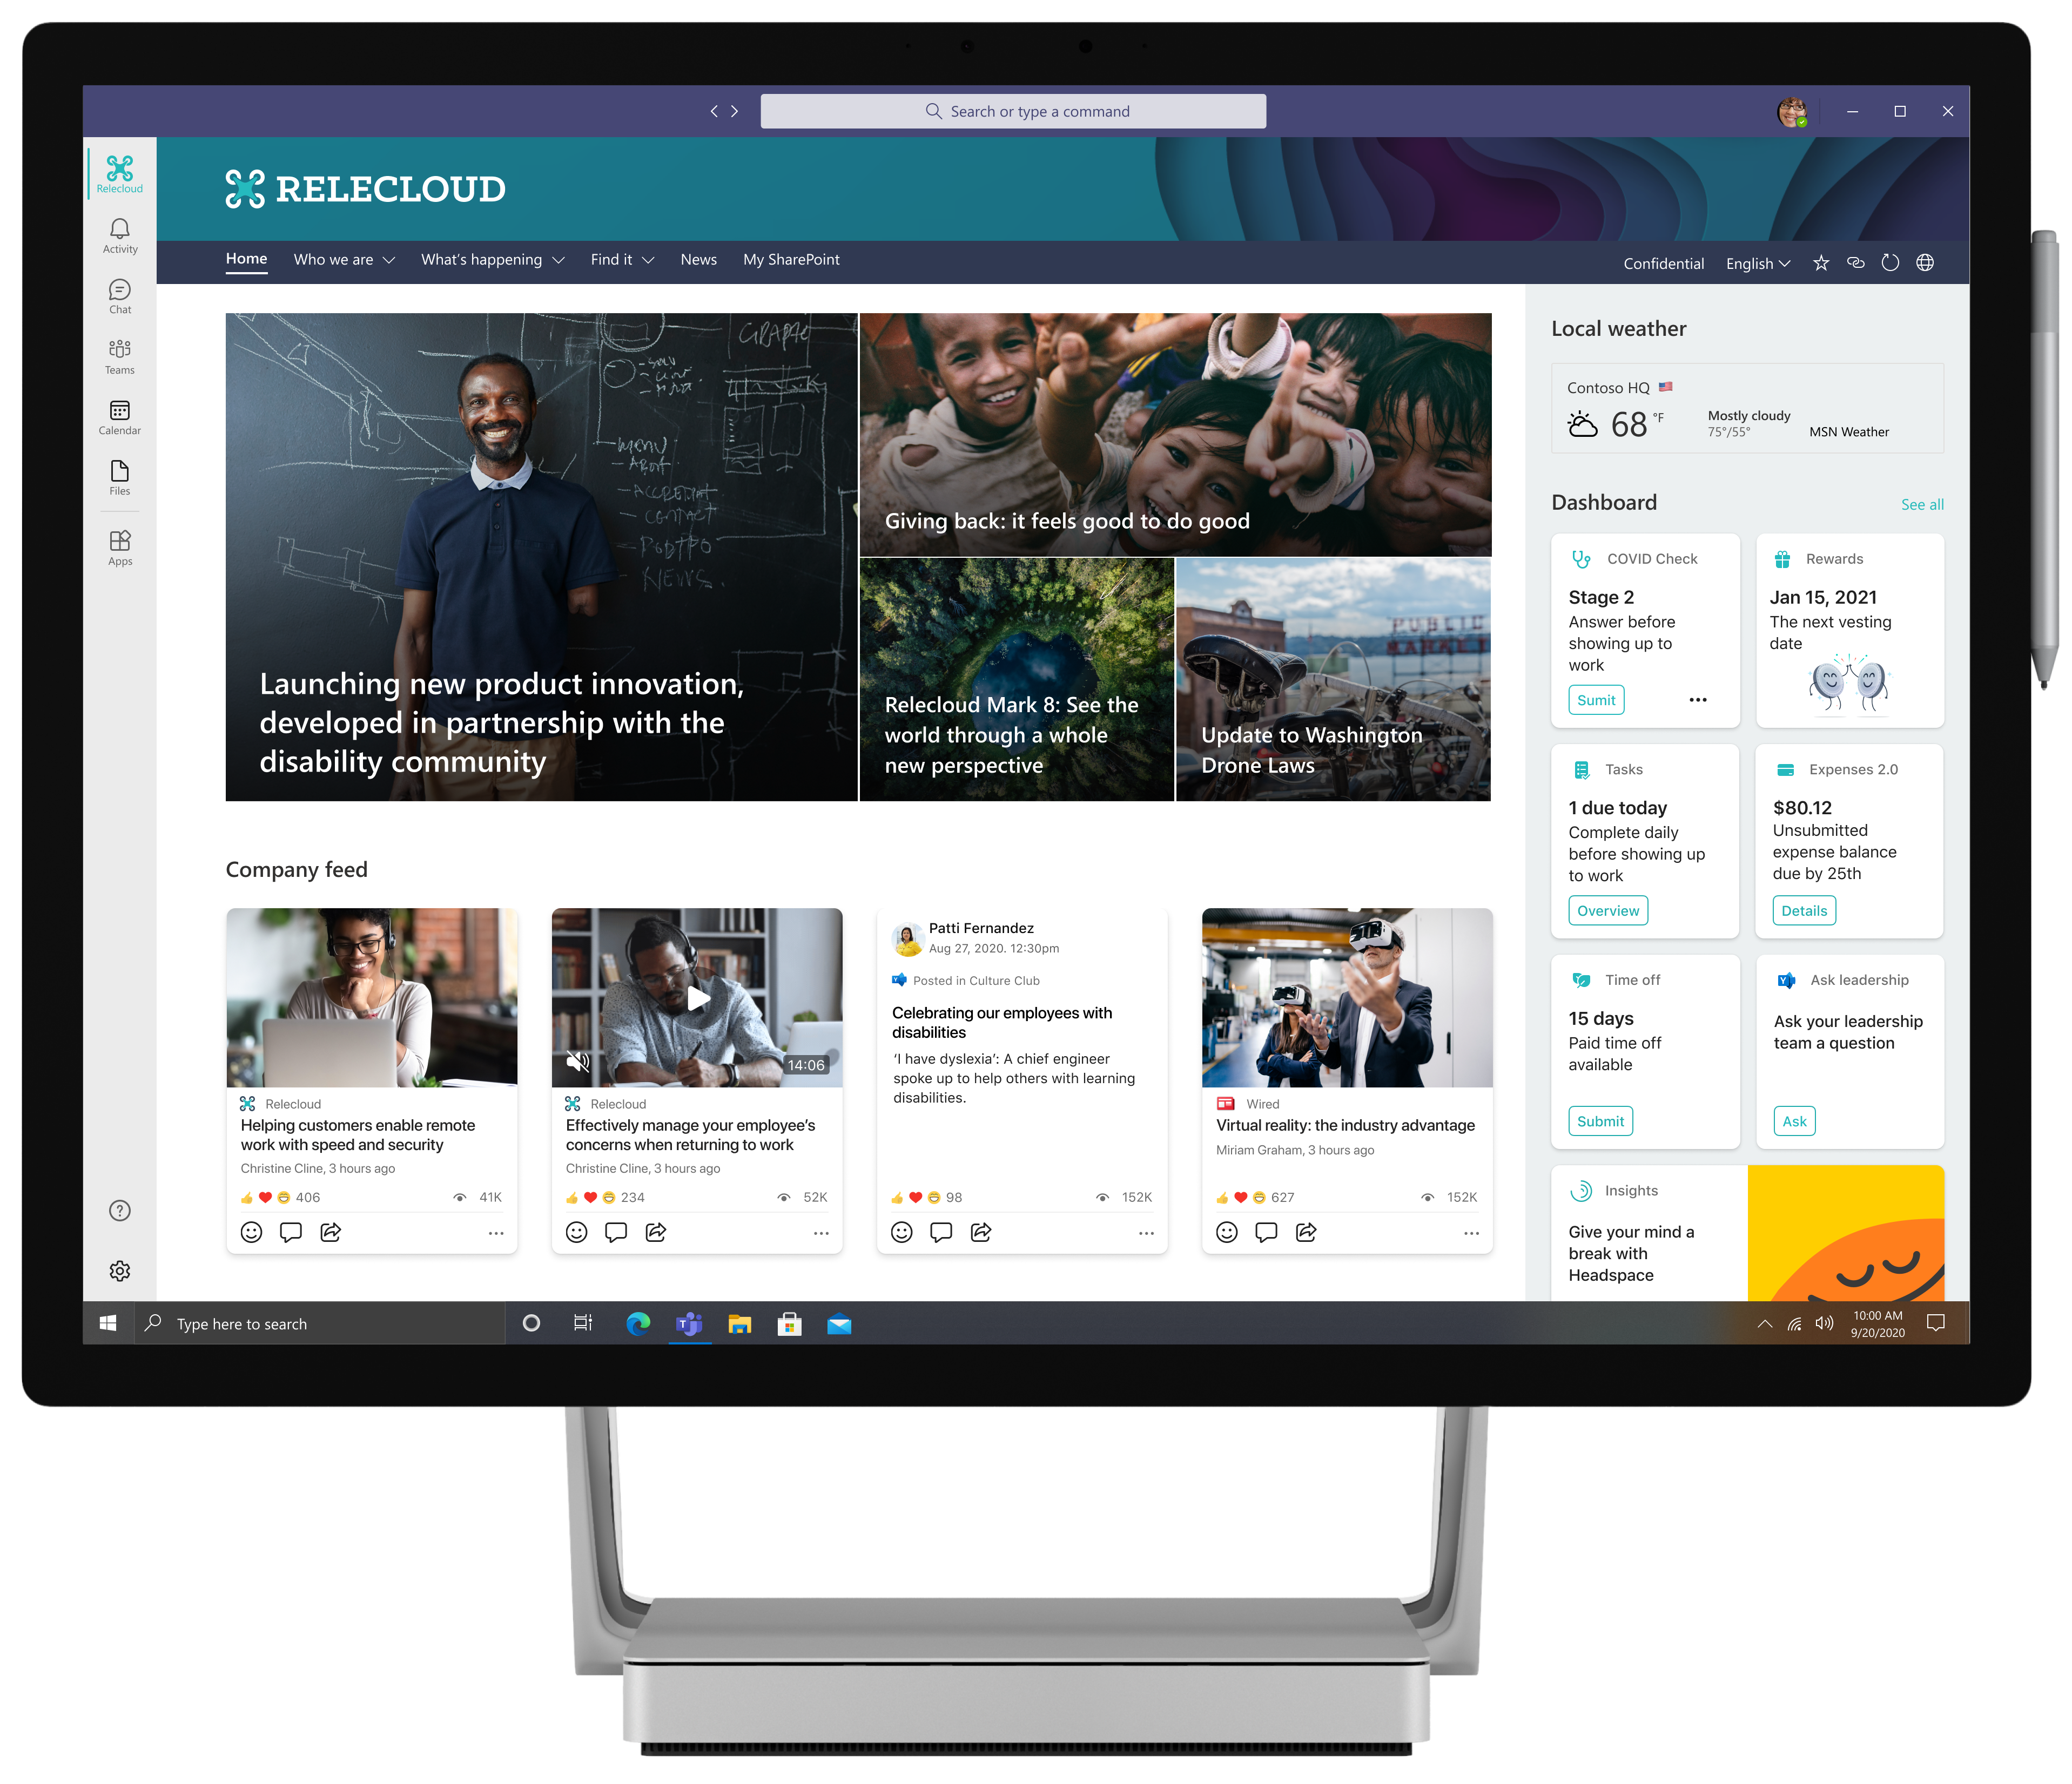
List and library form extensibility included!
UPDATE
SharePoint Framework 1.15 Release Candidate (RC) now available!
Release Candidate on the upcoming SharePoint Framework version now available with updated features for Microsoft Teams, Microsoft Viva and SharePoint Online
npm install -g @microsoft/generator-sharepoint@next
Notes:
Dan’s slide

Slide 12
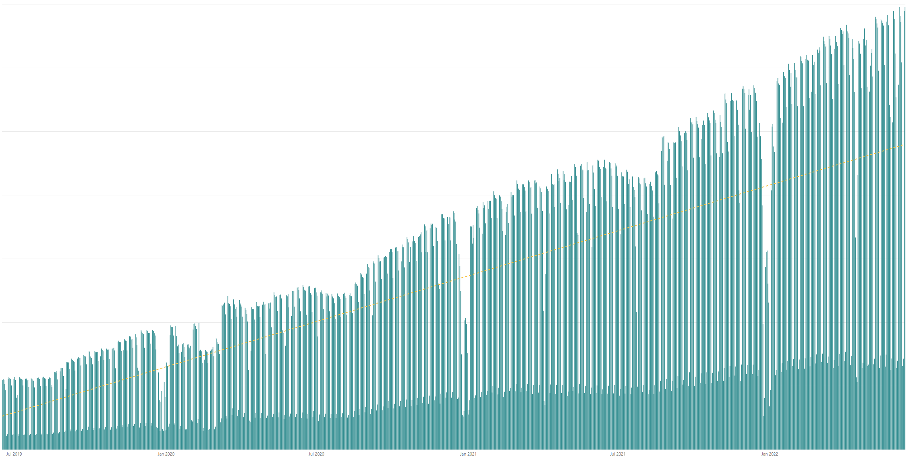

Rolling 28 days active users (MAU) for custom SharePoint Framework components in M365 There are currently tens of millions of monthly active users for customer and partner created SharePoint Framework components in Microsoft 365
All time highest usage in a day – Tuesday 14th of June 2022
Jul 2019
Jan 2020
Jul 2022
Jan 2021
Jul 2021
Jan 2022

Slide 13




The Road Ahead – 1.15 Release – ETA June 2022
Q2 CY 2022
1.15 release candidate (RC) – Released 2 weeks ago
New Action types for media and geolocation – Tutorial just published
Support for Microsoft Graph SDK V3
ESLint support
Support for TypeScript V4.5
Support for Teams SDK v1.12.1
Bug fixes and adjustments based on GitHub issues
New customizers for add and edit list / library forms
Nodejs v16 support
Available later as we progress in 1.15 development
Adaptive Card Extensions card view caching
Adaptive Card Extensions Error Handler Method
Adaptive Card Extensions card view caching – move to GA
Leverage Teams OBO flow for SPFx components in Teams Web
Enable Service Principal Registration in app acquisition flow
Isolated Adaptive Card Extensions (Beta)
Post 1.15 – 1.16 beta planned to get released in July
Bots Powered Adaptive Card Extensions (Beta)**

Slide 14

PnPjs Client-Side Libraries

Slide 15
























PnPjs Client-Side Libraries
Version 3.4 released June 10th
General documentation updates
Various bug fixes...
SchedulePublish added for client-side pages
Added paging support for graph
Added Recycle Bin support
Added Bookings endpoint to the graph
Beta support for cancelling requests
Version 3.4.1 released June 13th to reverse issue with library not working in Safari (iOS) browser.
Don’t forget about the nightly builds
npm install @pnp/sp@v3nightly --save
Docs: https://pnp.github.io/pnpjs/ @m365pnpjs on twitter

Slide 16
CLI for Microsoft 365

Slide 17
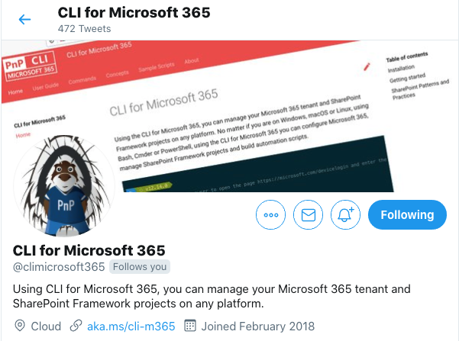
CLI for Microsoft 365
New preview v5.4 with:
Support for upgrading SPFx projects to v1.15.0-rc.0
Removing Planner tasks and adding task checklist items
Simplified working with Planner buckets
Improved retrieving list- and site columns
Removing role definitions in SharePoint sites
Support for creating list views using a query
...and more!
Install preview v5.4:
npm install -g @pnp/cli-microsoft365@next
docker run --rm –it m365pnp/cli-microsoft365:next
Release notes:
https://pnp.github.io/cli-microsoft365/about/release-notes/#v540
Available natively in Azure Cloud Shell
@climicrosoft365 #CLIMicrosoft365 on Twitter
📖 aka.ms/cli-m365
🗣 github.com/pnp/cli-microsoft365/discussions

Slide 18
SPFx Reusable Components

Slide 19
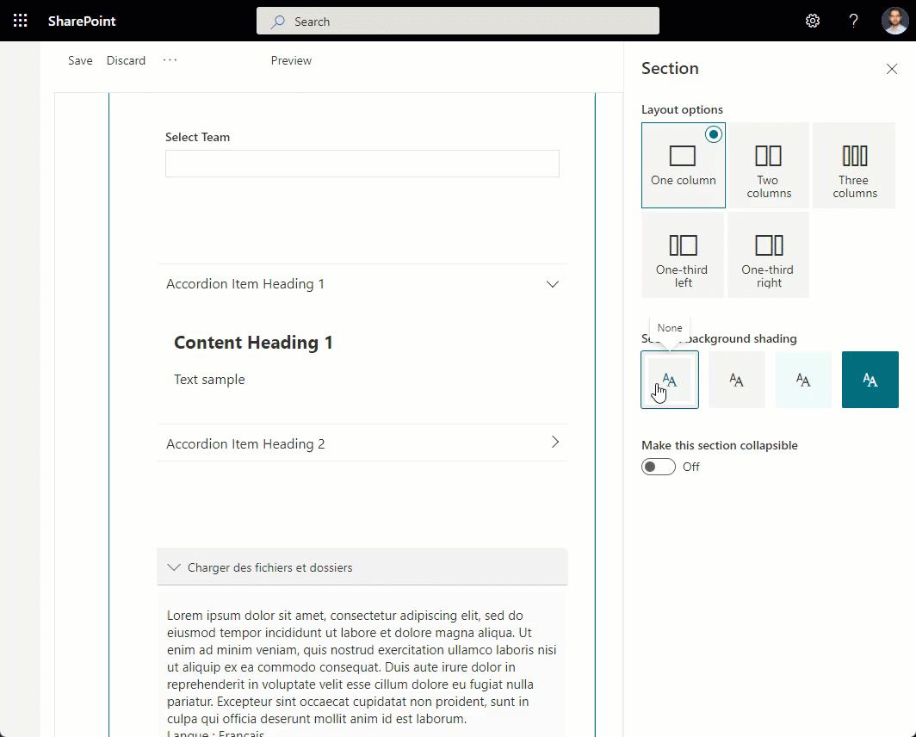
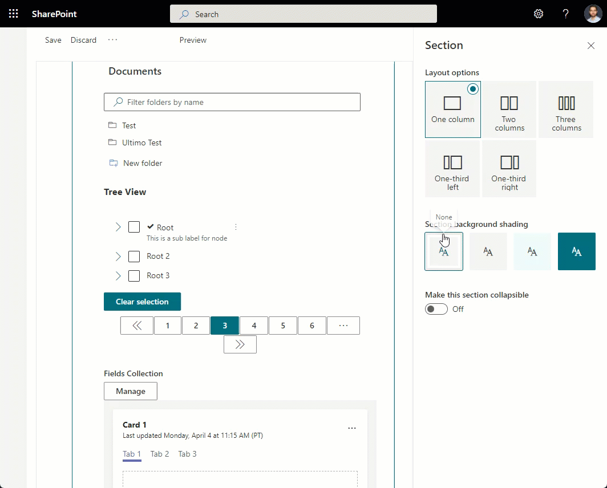
Reusable SPFx Controls
React Controls – 3.8.0
PeoplePicker enhancements: ability to provide multiple group id-s, search in nested groups
AdaptiveCardHost enhancements: add SPFx context, re-think CSS classes generation
Support for section backgrounds in AccessibleAccordion and TreeView
Various fixes
Release notes: https://pnp.github.io/sp-dev-fx-controls-react/about/release-notes/
React Property Controls – 3.7.0
PropertyFieldListPicker: ability to provide content type id
PropertyFieldColorPicker: provide preview of the selected color
Release notes: https://pnp.github.io/sp-dev-fx-property-controls/about/release-notes/
Special thanks to our contributors: Andreas Omayrat, brianpmccullough, Christophe Humbert, Fabio Franzini, Gautam Sheth, Joel Lopes, Milan Holemans, Patrik Hellgren, Ravichandran Krishnasamy, Rico van de Ven, Russell gove.
More information:
https://sharepoint.github.io/sp-dev-fx-property-controls https://sharepoint.github.io/sp-dev-fx-controls-react
Twitter: @M365PnPControls

Slide 20
PnP Modern Search

Slide 21
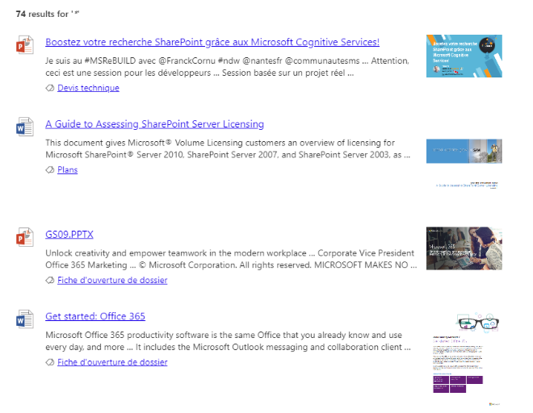

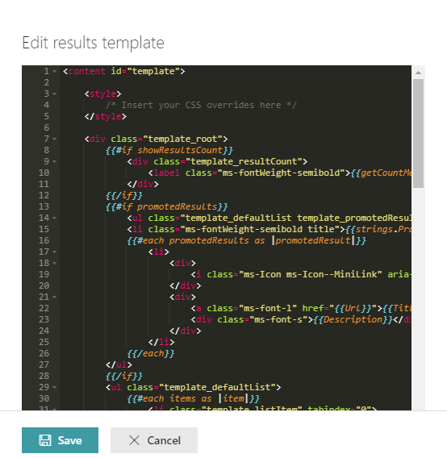
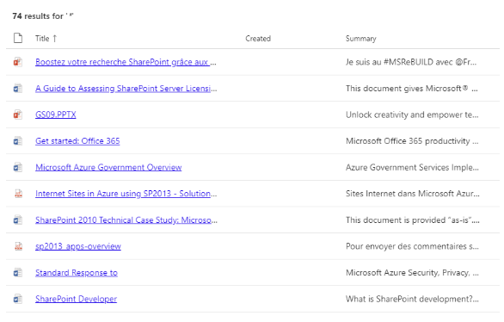

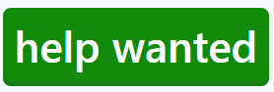
PnP Modern Search
http://aka.ms/pnp-search
Building modern Search experiences with flexible web parts
v4.7.0-pre – June 2022 release (soon)
https://github.com/microsoft-search/pnp-modern-search/releases/latest
Thank you @d-martins, @bruzie, @rick-brown-slalom, @mrjarbenne, @davemehr for your support
Support for Adaptive Card rendering
See release notes for fixes and new features
v3.23.0 – December 2021 release
https://github.com/microsoft-search/pnp-modern-search/releases
See release notes for fixes and new features
Notes:
https://github.com/microsoft-search/pnp-modern-search

Slide 22

PnP SPFx Samples

Slide 23
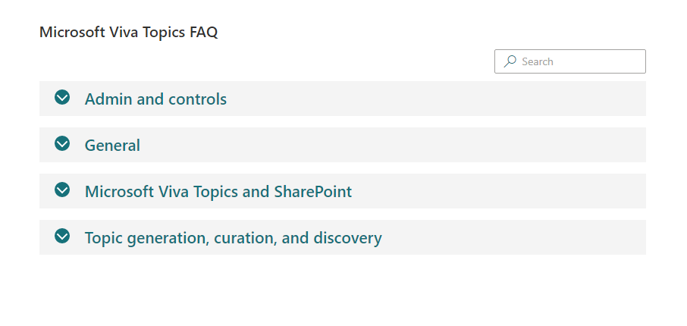
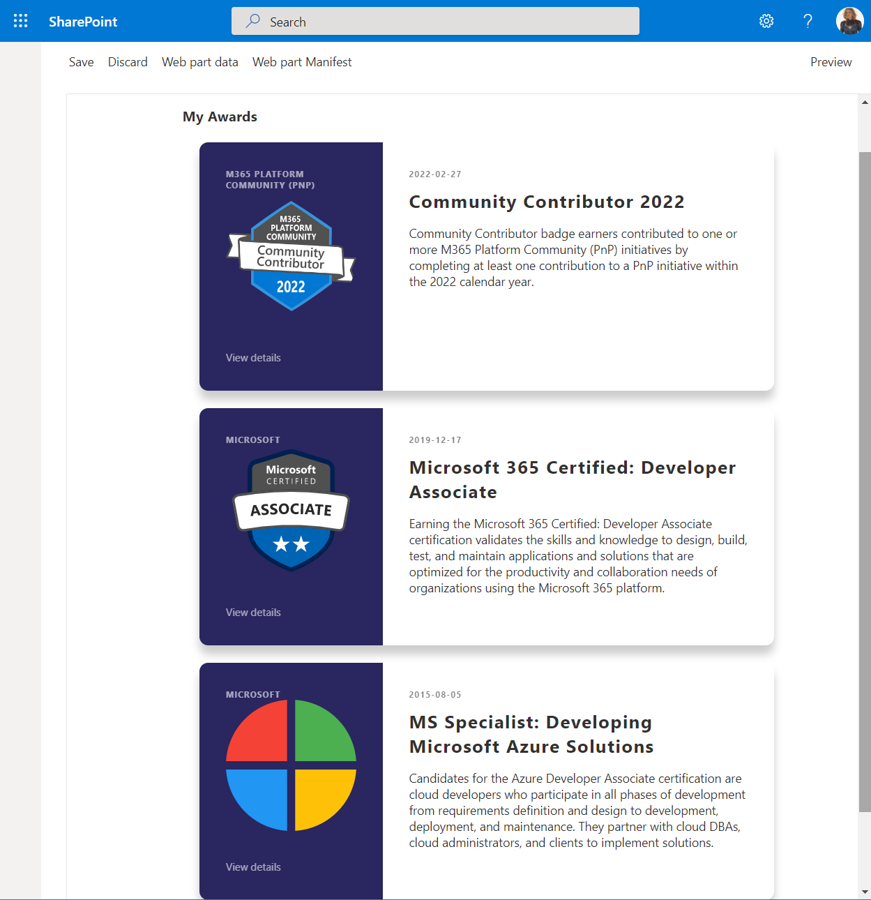
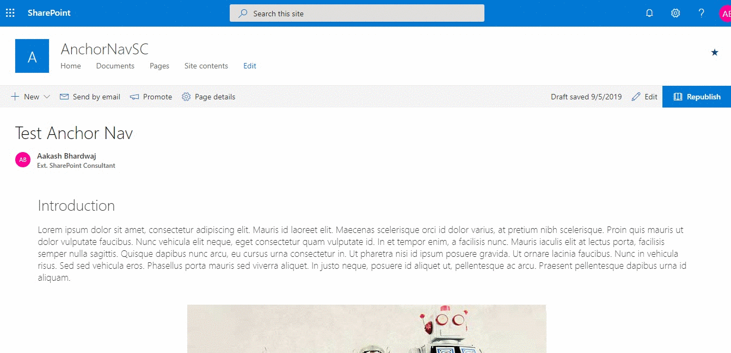
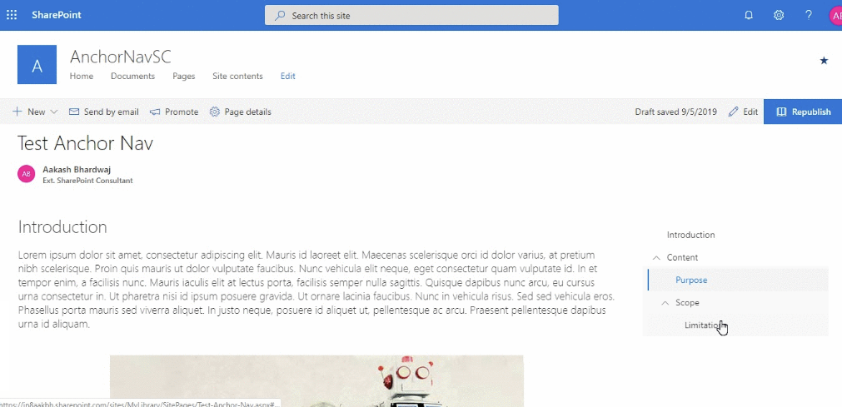
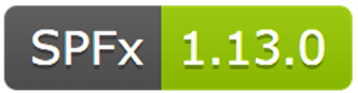
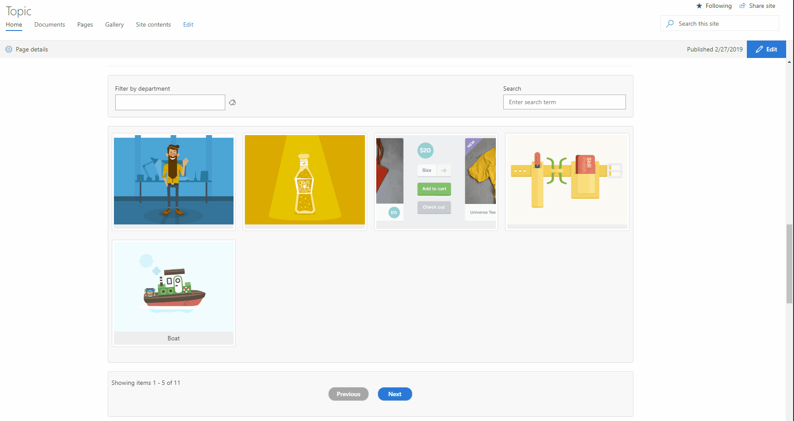
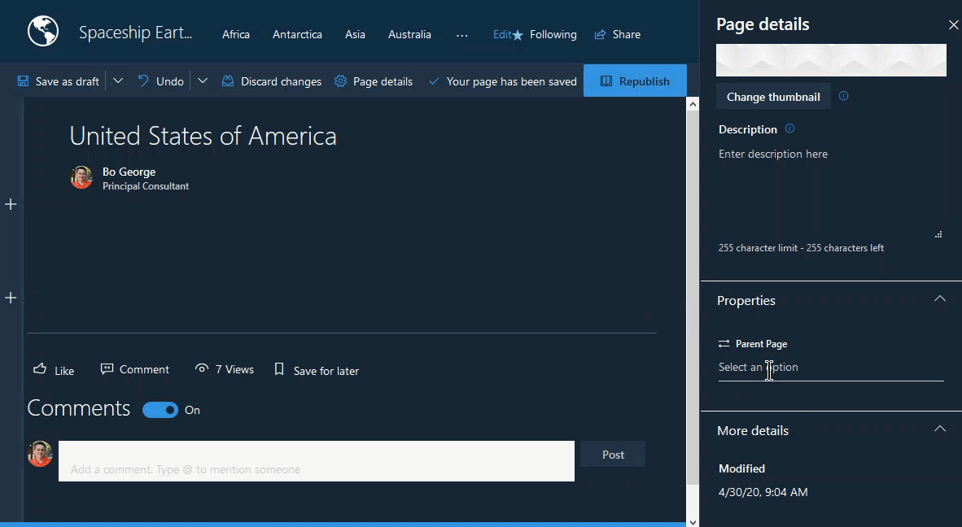
PnP SPFx Samples
PnP SPFx Samples
PnP SPFx Samples
https://aka.ms/spfx-extensions
Contributions welcome
https://aka.ms/spfx-webparts
Page Navigator Jasey Waegebaert | Jwaegebaert
Script Editor Felix Bohnacker | felixbohnacker
Follow Documents André Lage | @aaclage
Notes:
SPFx extensions https://aka.ms/spfx-extensions
NOPE
SPFx web parts https://aka.ms/spfx-webparts
Page Navigator
Jasey Waegebaert | Jwaegebaert Updates the React package from ^16.14.0 to 16.13.1. This has been done because SPFx v1.14.0 makes use of React 16.13.1.
https://github.com/pnp/sp-dev-fx-webparts/tree/main/samples/react-page-navigator
Script Editor
Upgrade to SPFx version 1.13.1
Felix Bohnacker | felixbohnacker

Slide 24
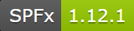
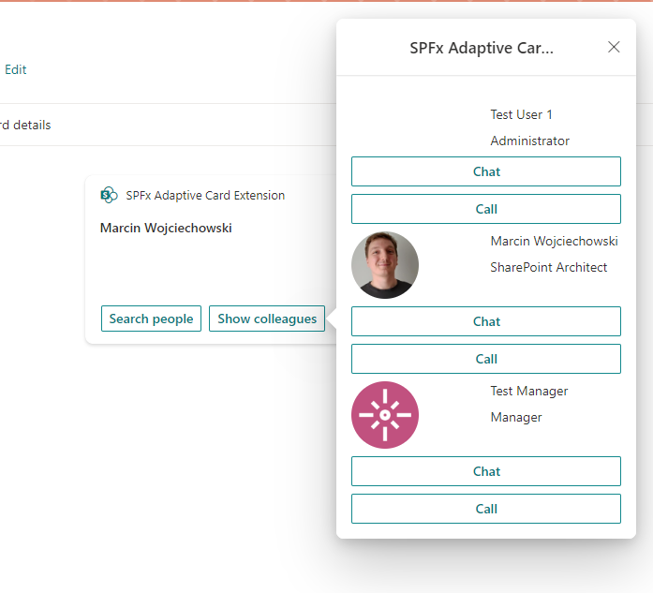
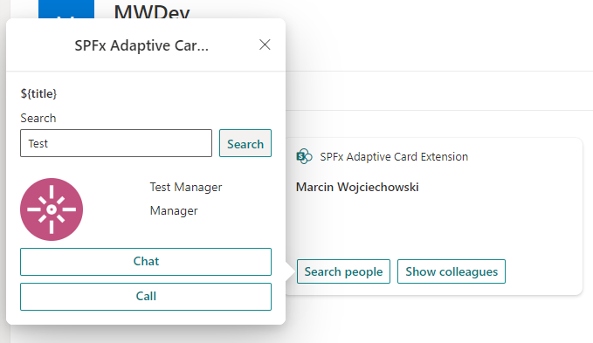
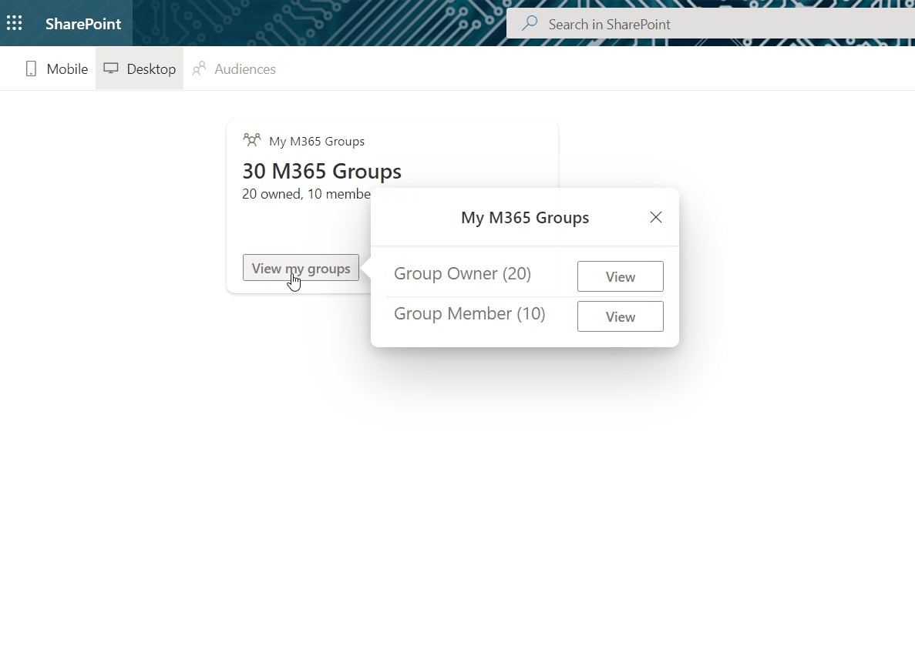
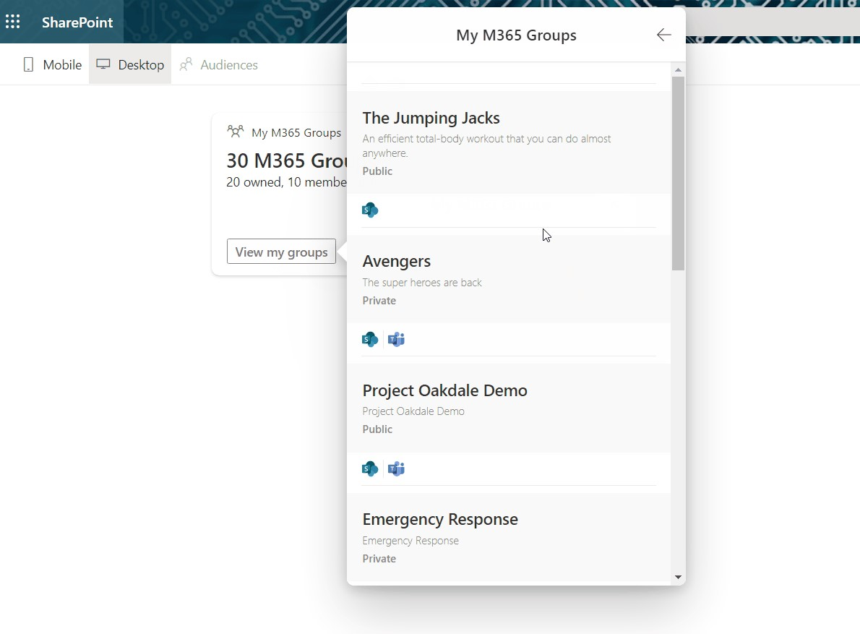
PnP SPFx ACEs
PnP SPFx Samples
PnP SPFx Samples
https://aka.ms/spfx-aces
Card Composition – Multi Card View Marcin Wojciechowski | @mgwojciech
UPDATES
My M365 Groups - New Search & Grouping - Nanddeep Nachan | @NanddeepNachan
Additional PR's Being Processed
*** We Love New Samples ***
Follow Documents André Lage | @aaclage
Notes:
This adaptive card extension sample demonstrate ability to monitor security risks using identity protection graph api from Viva Connection Dashboard
SPFx extensions https://aka.ms/spfx-extensions
Copy/Move Items within Lists Sudharsan Kesavanarayanan | @sudharsank This application customizer will display a command button named Copy/Move Item(s) in all the custom lists. Using this option, the items can be copied or moved from one list to another within the site.
https://github.com/pnp/sp-dev-fx-extensions/tree/main/samples/react-command-copy-move-items
SPFx web parts https://aka.ms/spfx-webparts
Applications Secrets Expiration Aimery Thomas | @a1mery This sample web part shows the list of your applications registered in Azure AD along with their associated client secret/certificate expiration date. https://github.com/pnp/sp-dev-fx-webparts/tree/main/samples/react-graph-app-secret-expiration
Teams Membership Updater
Nick Brown | @techienickb
Fixed the /members in the private channel membership URL
Advanced Page Properties Abderahman Moujahid | Abderahman88
Added support for web parts on sites in a different language
NEW: News Alison Collins | ReactIntern Web part pulls all SharePoint News Posts that the logged in user has access to view.
Pagination ( Back/Next ) and Page Display ( n out of n )
Select Multiple Sites ( Defaults to site webpart is deployed to )
Two styling options, Stack or Single
News Title as link ( Click to go to post )
News Thumbnail Image
Preview of Description
Author ( Can toggle visibility in Property Pane )
Created Date
Likes with Office UI Fabric Icons
Comments with Office UI Fabric Icons ( Also retrieves nested comments )
https://github.com/pnp/sp-dev-fx-webparts/tree/main/samples/react-news

Slide 25
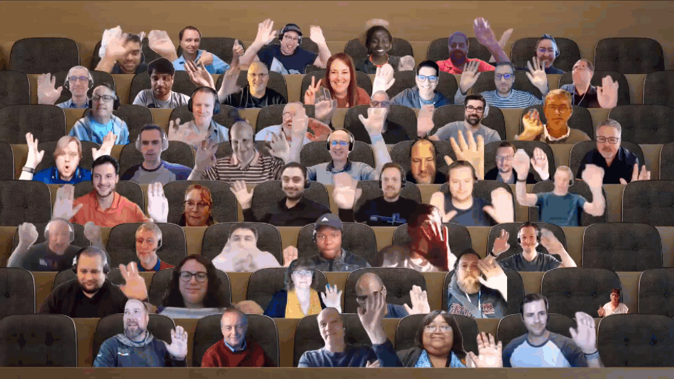

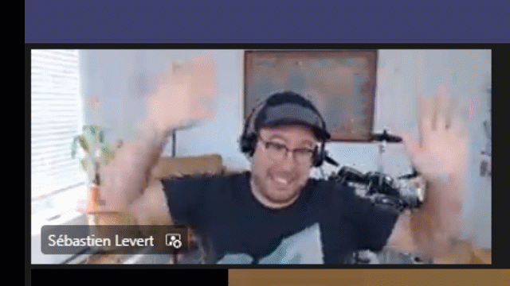
Optional picture time!
Video on and we’ll grab a Together Mode pic with those who are willing to do this.
We are together on this as a community!
Let’s all be like Seb?
By enabling your camera for the picture, you grant us permission to share your picture in social media.

Slide 26

DEMO
Aiming for a safer Content Editor Web Part – Christophe Humbert
Getting started on using GitHub Codespaces with your SharePoint Framework solutions – Emanuele Bartolesi
MyShifts - Adaptive Card Extension – Siddharth Vaghasia

Slide 27
Thank you
Recording will be available in 24 hours on
Microsoft 365 Community (PnP) YouTube channel
https://aka.ms/M365/videos
(subscribe today)
Follow us on Twitter
@Microsoft365Dev | @M365PnP
Next Viva Connections & SPFx call: June 30th at 07:00am PT
Next M365 General Dev call: June 23rd at 07:00am PT
All available community calls from https://aka.ms/m365/calls

Slide 28


aka.ms/m365pnp

